Slide 1
SharePoint 2010 Security
Understanding Claims-based Security
Notes:
Every developer needs to have a firm grasp on how security (authentication & authorization) works in SharePoint as with any application. Microsoft has added a new security model to SharePoint 2010: claims based authentication. In this module you will learn how claims based authentication works, how to set it up and interact with it programmatically as well as how to create a custom claims provider.

Slide 2
Agenda
SharePoint Security Overview
Security Programming Fundamentals
Claims-Based Security

Slide 3
Security 101
Authentication and Identity
Authentication creates identity for security principal
Identities stored in user accounts repository
Authentication performed using credentials
Authentication produces some form of badge
Authorization and Access Control
Subsystem used to define security policy
Privileged users configure ACLs on objects
Subsystem enforces policy at run time
Notes:
The two most basic concepts in computer security are authentication and authorization. Authentication is a process the answer the basic question "who are you". Authorization answers the basic question, "what can you do". In most scenarios, a user must be authenticated and his/her identity must be known before the system can determine whether that user should be given access to a requested resource.

Slide 4
SharePoint Authentication
SharePoint relies on external components
Windows Authentication authentication managed by Windows Server and IIS
Forms Based Authentication (FBA) authentication managed by ASP.NET and an authentication provider
Claims Authentication authentication managed by a security token service (STS)
SharePoint creates profile for external identities
Identity tracked per site collection in User Profile List
Identity seen by developers as SPUser object
Notes:
SharePoint 2010 does not implement its own system for authentication sub-system or offer any services for identity management. Instead relies solely on external systems, whether Microsoft Windows, ASP.NET or some of the new available identity management services made available under the new claims-based security model.
Although SharePoint doesn’t perform authentication, it does manage user identities and perform authorization. After authentication, SharePoint tracks each user by using a user security profile stored within the current site collection. SharePoint supports the assignment of permissions to security principals. There are two types of security principals: users and groups. SharePoint checks the user’s security token against binary access control lists.

Slide 5
User Information List
Site collection has User Information List (UIL)
UIL is created automatically in every top-level site
UIL is effectively hidden from users
UIL tracks security principals using integer ID
AD users and groups (external)
FBA members and roles (external)
Claims-based identities (external)
SharePoint groups (internal)
Notes:
Every SharePoint site collection contains a User Information List that caches profile information of each user who accesses the site. The user information list is a hidden list created automatically in every top-level site. External users and external groups are each given a unique integer ID that is used in the access control list entries that are used to configure authorization and enforce access control.

Slide 6
DEMO
Examining the User Information List

Slide 7
Agenda
SharePoint Security Overview
Security Programming Fundamentals
Claims-Based Security

Slide 8
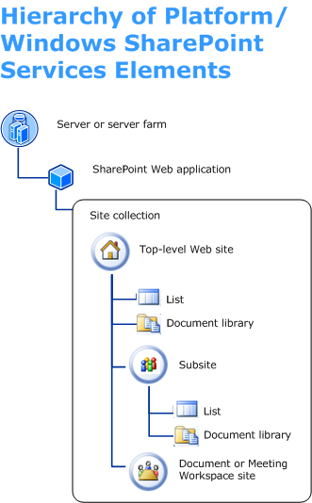
Securable Objects
Each site collection is a hierarchy
Each object may have its own ACL
Object without ACL relies on parent
Top-level site is top-level object in hierarchy
Notes:
The request of an authenticated user runs under the context of an SPUser object and carries a security token. When you create an object reference to an SPSite site collection, SharePoint creates an instance of the SPUserToken and the SPUser. As the code attempts to access resources, SharePoint checks this user’s security token against binary access control lists (ACLs) to determine whether it should grant or deny access. An ACL is simply a data structure associated with a target SharePoint object, such as a site, list or list item that tracks the rights of users and groups.
SharePoint objects may either use their own ACL or inherit the rights of the parent object.

Slide 9



Securable Objects OM
SPUser represents external security principal
SPGroup represents SharePoint group
N
SP User
N
N
SP Group
Rights
N
N
1
N
Role Definition
1
N
Role Assignment
N
AuthZ
Resource
SP User
Notes:
The SharePoint object model tracks user identities by using the SPUser class. If you want to access the SPUser object for the current user, you use the SPWeb.CurrentUserproperty associated with the current site. The current user is always the user who has authenticated when the SPSite site collection object was created.
SharePoint supports the creation of groups within a site collection to ease the configuration of authorization and access control. SPGroup object are created at the level of the site collection and assigned to a site. Adding a group to a site collection does not assign rights to the group. You have to create a new SPRoleAssignment by associating an SPRoleDefinition with the SPGroup, and then add that role assignment to the site.

Slide 10
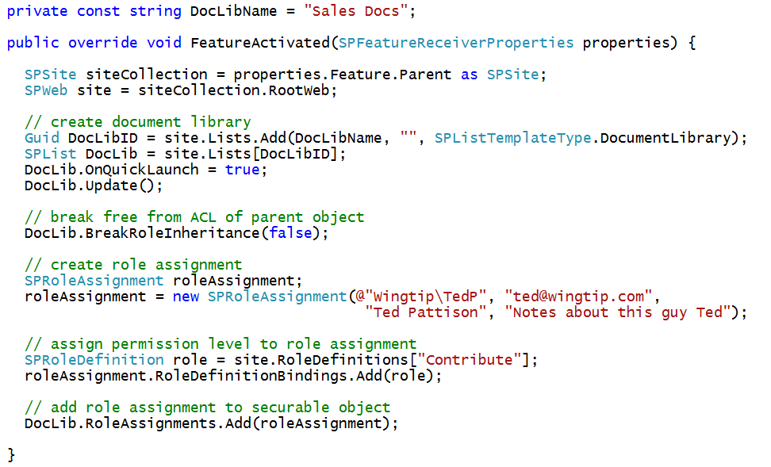
Programming with Permissions
Notes:
Each security object has the potential to have its own unique access control list. However, by default the only securable object to get an access control list is the top-level site. To configure unique permissions on a different securable object, you can call the BreakRoleInheritance method to create a unique access control list and then add permissions using an SPRoleAssignment as shown in the code in the slide above.

Slide 11
DEMO
Configuring Permissions with Code

Slide 12
IIS Application Pool Identity
SharePoint Worker process has its own identity
Configurable in Central Administration
Should be configured with AD domain account
Account must access configuration DB and content DBs
Notes:
The SharePoint Worker process is launched from the IIS executable W3WP.EXE and is configured with a specific identity. It is a best practice to create dedicated
Active Directory accounts (e.g. WINGTIP\SP_WorkerProcess) to serve as the worker process identity for various Web Applications.
Note that the Active Directory accounts which are configured as the identities for Web Application are sensitive because they are configured with read and write permissions to the configuration DB and content DBs. It would be a bad thing if a malicious user were able to figure out the user name and password of these accounts.

Slide 13
SHAREPOINT\System Account
WSS 3.0 introduced SHAREPOINT\system
Hides IIS Application Pool Identity from users
Runs as God within SharePoint authorization system
Removes need to treat Application Pool Identity as site user
Notes:
The application pool identities play a large role in SharePoint applications because they are used to connect to the SharePoint content and configuration databases.
The SHAREPOINT\system account is an identity to which SharePoint maps internally when code is running under the identity of the hosting application pool. This account is not recognized by Windows because it exists only within the context of the SharePoint runtime environment. This enables SharePoint to use a statically named account for system-related activity regardless of whatever Windows user account has been configured for the hosting application pool.

Slide 14
SharePoint Identity vs. Windows Identity
Web Server
Pages, Lists & Documents
SharePoint content
Web Application Worker Process
Authorized using SharePoint Identity
Authorized using Windows Identity
AdventureWorks Database
SQL Server
XML File
local file system
Notes:
An Application Pool can contain one or more applications and allows us to configure a level of isolation between different Web applications. Because each application pool runs in its own worker process, errors in one application pool will not affect the applications running in other application pools.
The worker process is authorized to use the SharePoint identity to access the SharePoint sites and its pages, lists and document libraries.
The worker process is authorized to use the Windows Identity to access other sources like SQL Server databases.

Slide 15
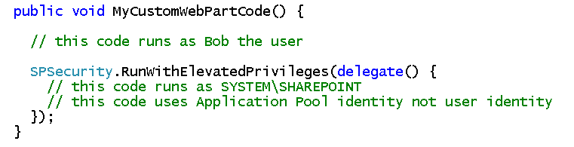
Elevation of Privileges
Code typically runs under identity of user
Authorization works as expected in SharePoint
Sometimes code must do things current user cannot do
Custom code elevate privilege
Advantage: elevated code can do anything
Disadvantage: elevated code can do anything
Notes:
A privilege is the right of an account, such as a user or group account, to perform various system-related operations on the local computer.
Code typically runs under the identity of the logged on user. But there are cases that actions need to be performed on behalf of the system. Therefore the SPSecurity class provides a static method RunWithElevatedPrivileges that enables code to execute as system code running under the identity of SHAREPOINT\System. This method should be used with care.
When using this method in code your can either create a delegate to a public void method or simply write code within an inline delegate. Code within the delegate runs under the SHAREPOINT\System security principal. This account uses the application pool identity when passing credentials to external resources.

Slide 16
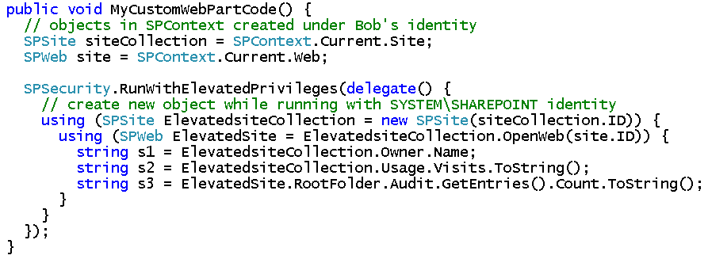
SPSite and Elevated Privileges
Accessing sites with WSS object is tricky
Must create new SPSite object after elevating
Notes:
After elevation of the privileges, you have to create a new SPSite object and SPWeb object to switch the security context. Creating a new SPSite object to generate a new security context. You cannot switch the security context once it has been created.

Slide 17
Agenda
SharePoint Security Overview
Security Programming Fundamentals
Claims-Based Security

Slide 18
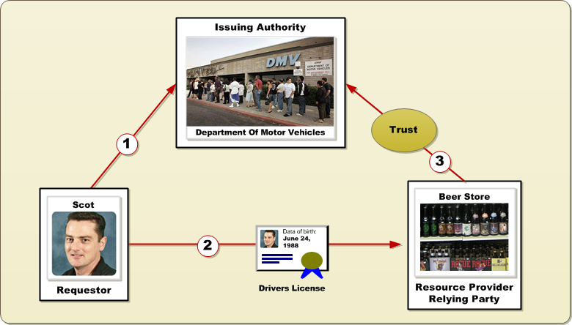
Identity
A profile representing a person or entity
Verified through some type of document (e.g. drivers license)
Document issued to requester by trusted authority (e.g. DMV)
Requestor presents document to resource provider
Resource provider is 'relying party' which trusts issuing authority
Relying party enforces authorization based on identity attributes
Notes:
Identity is a concepts that suggests a profile representing a person or entity such as a company or organization. In everyday life, the identity of people are verified through the use of some type of document such as a drivers license. The basic steps of how identity is verified can be used as a basis for understanding computer security systems.
For example, a drivers license is a document issued to a Scot (the requester) by trusted authority (the department of motor vehicles). When Scot wants to buy beer, the beer store wants to have some proof that he is of the legal age. Scot presents his drivers license to the person behind the counter at the beer store and this person recognized that the drivers license has been created by a trusted authority. Therefore, the person behind the counter can assume that any information on the drivers license is a fact and can used as a basis for giving access to a resource.
In security terminology, the person behind the counter at the beer store is a "relying party" because the decision to give away access to a resource has been made by relying on information provided by a trusted authority.

Slide 19
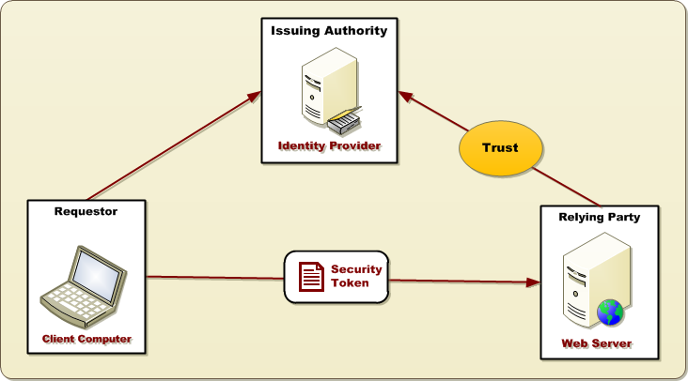
Digital Identity
Identities created/managed by identity provider
Identity provider requires authority to issue security tokens
Relying party uses security tokens to verify identity
Relying Party uses identity to make decision about access control
Notes:
In the world of computer security, digital identities are created and managed by services that are often called "identity providers". An identity provider is the subsystem that stores user credentials such as login names and password. The identity provider is also the subsystem that performs authentication and passes out security tokens which relying parties can use to make decisions about whether to allow access to resources.

Slide 20
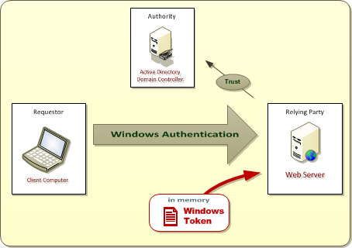
Windows Authentication
Active Directory plays role of Identity Provider
Identities can only established using Windows accounts
OK for intranets scenarios where users are employees
Bad for scenarios which require external users Windows accounts must be created/managed in Active Directory for partners, customers, etc.
Notes:
Since the release of its first version in 2001, SharePoint has also supported Active Directory as an Identity Provider. This means that a security system for authentication and authorization can be setup and created using user accounts and groups within an Active Directory domain.
The requirement of using an Active Directory account for each user works well in intranets scenarios where the users are all employees and each user already has an Active Directory account that they use to log onto the network.
However, the requirement of using an Active Directory account for each user doesn't work as well for scenarios that involve external users such as contractors, partners of customers. That's because a company's IT staff is forced to create a new Active Directory for each user. In some cases this is a pain point. In other cases it is simply not allowed due to company policies.

Slide 21
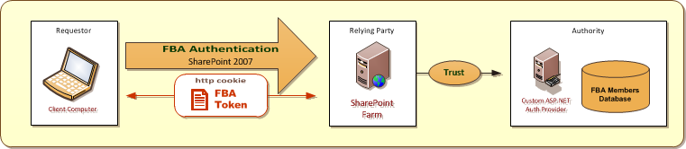
Forms-Based Authentication (FBA)
SharePoint 2007 Introduced Support for FBA
Based on pluggable authentication provider model
Primary Benefit of FBA
User accounts can created and managed in custom repository
FBA Drawbacks
SharePoint provides no support for creating/managing FBA users
FBA token not based on standards – it's proprietary to ASP.NET
In 2007, FBA doesn't really work with Office client application
Notes:
SharePoint 2007 Introduced Support for Forms-based Authentication (FBA). FBA is a authentication protocol which is managed by the ASP.NET runtime and a pluggable authentication provider. The introduction of FBA with SharePoint 2007 was very welcomed because it broke SharePoint's tight coupling on Active Directory accounts that was considered very limiting in SharePoint 2003.
A primary benefit of using FBA in a SharePoint Web Application is that user accounts do not have to be stored in Active Directory. Instead, user accounts can be created and tracked in a custom repository such as a SQL Server database. This has made it far more practical to create SharePoint sites which support users that are contractors, partners and customers.
However, there are also some noteworthy drawbacks to using FBA in SharePoint farms. First, SharePoint provides no direct support for creating or managing FBA users. Therefore, a company is forced to either develop or buy a user management package. Second, the FBA protocol is proprietary to ASP.NET and cannot be used to interoperate with other types of security systems. Last and possibly most important, the manner in which FBA is implemented in SharePoint 2007 doesn't really work with non-browser clients. This is a big problem for integrating Office client applications such as Microsoft Word and Microsoft Excel.

Slide 22
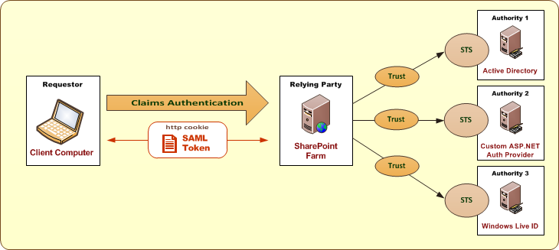
Claims-based Security
New model based on WS-* security standards
Designed to decouple authorities from relying parties
Authority provides security token service (STS)
STS creates and signs SAML-based security tokens SAML = Security Assertion Markup Language
Notes:
Many vendors in the software industry including Microsoft are pushing a new standard known as claims-based security. One of the main goals is to make Windows and non-Windows systems interoperate with each other. At its core, the new claims-based security model is based on a set of Web service specifications which are collectively known as the WS-* security standards.
At a high-level, the new claims-based model has been designed to decouple trusted authorities from the relying parties that use them. The trusted authority provides a standard service that a requester can use to acquire a security token known as a security token service (STS). The security tokens are created using standardized XML in a new language known as Security Assertion Markup Language (SAML). These SAML tokens can be passed from machine to machine and from Windows systems to non-Windows system and vice versa. The SAML token is signed by the STS and any relying party that trusts the STS can inspect the SAML token and assume whatever is seen inside is a fact.

Slide 23
Claims-based Security in SharePoint 2010
SharePoint 2010 support claim-based security
Configured at Web Application scope
Web Application can use new model or classic model
What are the benefits of using the new model?
Decouples SharePoint from authentication provider
Allows for new authentication providers (e.g. Live ID)
Multiple authentication providers can use same URL
Identity can be passed without Kerberos delegation
Custom claim providers open up new possibilities
Notes:
SharePoint 2010 has been designed to support the new claim-based security model. Whenever you create a new Web Application, you make the decision of whether the new Web Application will support the new claims-based model or the older classic model.
There are several benefits to create Web Application that use the new claims-based model. First of all, it opens up the possibility of using an Internet service such as Windows Live ID as a SharePoint site's identity provider. Secondly, it allows you to have more then one authentication provider that can be used to access the same set of sites using a single URL. This was not possible in SharePoint 2007 as you need to configure a different URL for each type of authentication. For applications that require passing user identity from the Web server to backend application servers, claims makes this possible with requiring the configuration of Kerberos-style delegation which is not always possible to configure. Finally, it also opens the extensibility point for developers because they can create custom claim providers that open up new possibilities when it comes to how user security permissions are configured.

Slide 24
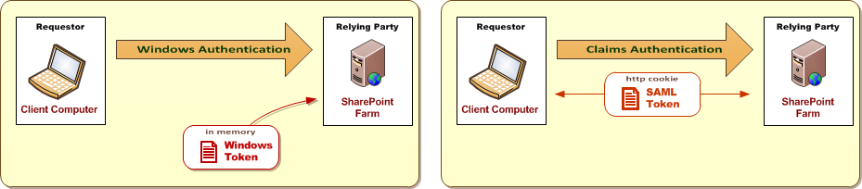
Classic Mode versus Claims Based
What's the same?
Support for Windows authentication with NTLM, Kerberos or Basic
Both support SSL and Anonymous Access
What is different?
Classic Mode relies on Windows tokens created on Web server
Claims Mode passes cookies between browser and Web server
Classic Mode only support Windows authentication
Claims Mode supports Windows authentication and more
Notes:
Imagine you have two Web Applications. One is configured to support the new claims model and the other is configured to run in classic mode and work the same way things did in SharePoint 2007. Also imagine a user named Bob is going to authenticate using his Active Directory account in order to gain access to sites in both Web applications.
When Bob authenticated against either Web application, the same thing happens at first. That is Bob is authenticated again a domain controller and a Windows security token is generated for him on the Web server. Inside the classic mode Web application, this Windows security token is cached and is used across multiple requests to provide Bob's identity to the SharePoint authorization system.
However, things are different in the claims mode Web application. After the Windows security token is generated for Bob, SharePoint calls to a local STS running on the Web server to convert the Windows security token into a SAML token. All the information that wa sin the Windows security token is added to the SAML token.

Slide 25
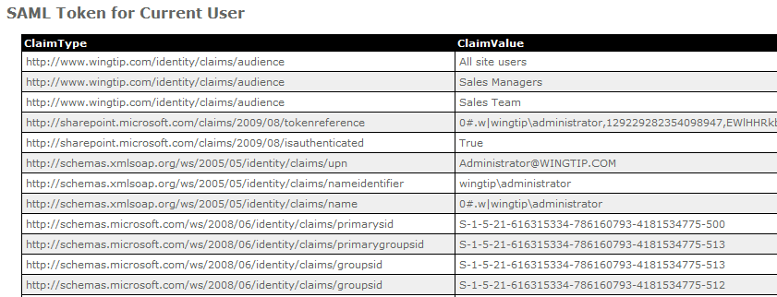
The SAML Token
Claims are stored as name-value pairs
Claim type identified as unique string in URI form
Custom claims can be added to token
Custom claims can be used to configure permissions
Notes:
As you can see from the screenshot in the slide above, claims are stored in a SAML token as name-value pairs. Each claim type is identified as unique string in the form of a URI. It is also possible for SAML token to contain more than one value for a given claim type.
One great aspect of this new model for developers is that it is possible to add custom claims into the SAML token. You can do this in a SharePoint Web Application by creating a custom claim provider as you will see in the upcoming demo.

Slide 26
DEMO
Developing a Custom Claim Provider

Slide 27
Summary
SharePoint Security Overview
Security Programming Fundamentals
Claims-Based Security

